Slide 1
HVAC Electronic Maintenance Record
Project Vision

Slide 2
Customer Desirables
Building owners need to comply with laws requiring record-keeping of maintenance records and reporting (e.g., EPA 40 CFR 82.154(c)(3), Utah Code R392-510-7, New York City Code 28-308.3)
Building owners are legally required to share records/reports with inspectors and regulators
Automated generation of reports can save owners time on time consuming tasks and reduce risk of facing expensive fines
Digital records provide many advantages over paper records
Fail-safe if original documents are lost or misplaced
Ease of access and accuracy of reporting
Third parties such as inspectors can easily be granted secure access to maintenance logs without needing paper documents
Building owners can have enhanced search and reporting abilities across multiple records
U.S. government policy supports moving towards electronic reporting
HVAC maintenance companies may want an easier way to share maintenance records (and gain a new revenue stream) with building owners
HVAC maintenance companies may want to have new functionality to analyze maintenance records to better understand work done by their technicians

Slide 3
Minimum Successful Project Features
Platform for HVAC maintenance companies to share digital maintenance records with building owners and comply to regulations in the target jurisdiction
Technicians need to be able to report maintenance tasks
Data needs to be stored in a maintenance ledger
Maintenance company needs to be able to manage technicians and units
Building manager needs to be able to view maintenance data and grant access to inspectors
Inspectors need to be able to view the legally required maintenance data
Automatically compile reports from the data to the required format so that building owners can comply with reporting regulations

Slide 4
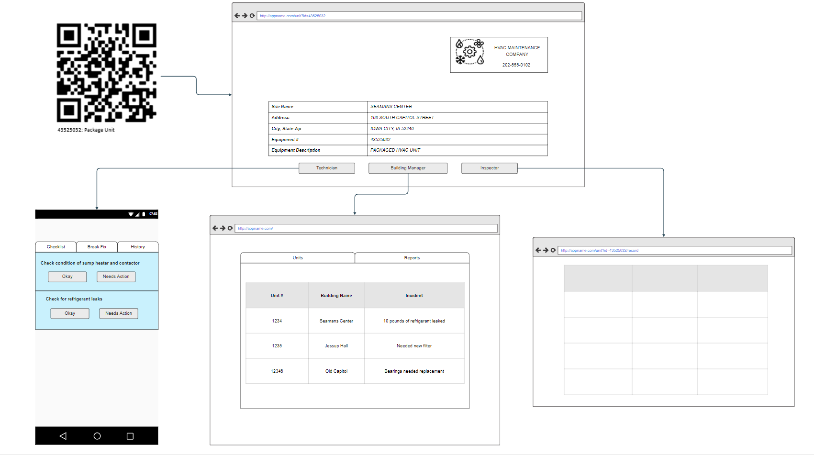

Slide 5
Technologies
Database: PostgreSQL
Frontend: Next.js
Backend: Django
Testing: Django (Backend), Cypress (Frontend)

Slide 6
Protocols and Measuring Progress
BDD & TDD
GitHub
Pull request templates & rules
Changes go into development branch first
Main branch is only for production and cannot be deleted
GitHub actions to automate testing for pull requests
Meetings
Tuesday, Thursday, Sunday standup
In-class meetings
Meeting with potential customer?
Zenhub to measure velocity

Slide 7
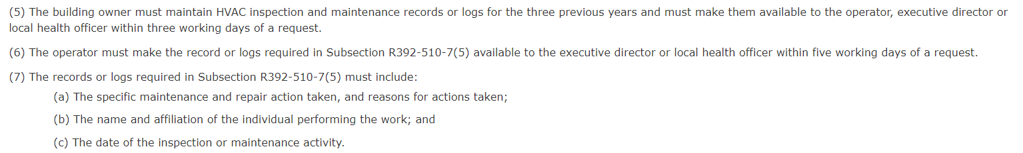
Scope & Acceptance
For the project we will use Utah as our target jurisdiction for minimum successful product (Utah Code R392-510-7).
For the project we will also implement the EPA reporting requirements for refrigerant leaks (EPA 40 CFR 82)
Keep application modular to be able to implement record-keeping and reporting requirements for other jurisdictions or new regulations
Acceptance can be determined by our team or an external reviewer if our product meets the legal requirements
Acceptance can also be done with a potential customer if found during the semester

